Slide 1
Patent Trial and Appeal Board update
Scott R. Boalick, chief administrative patent judge
November 14, 2019
Thought Leader Summit

Slide 2
Appeal and interference statistics
September 2019

Slide 3
Pending appeals FY10 to FY19 (Sept. 30, 2010 – Sept. 30, 2019)

Slide 4
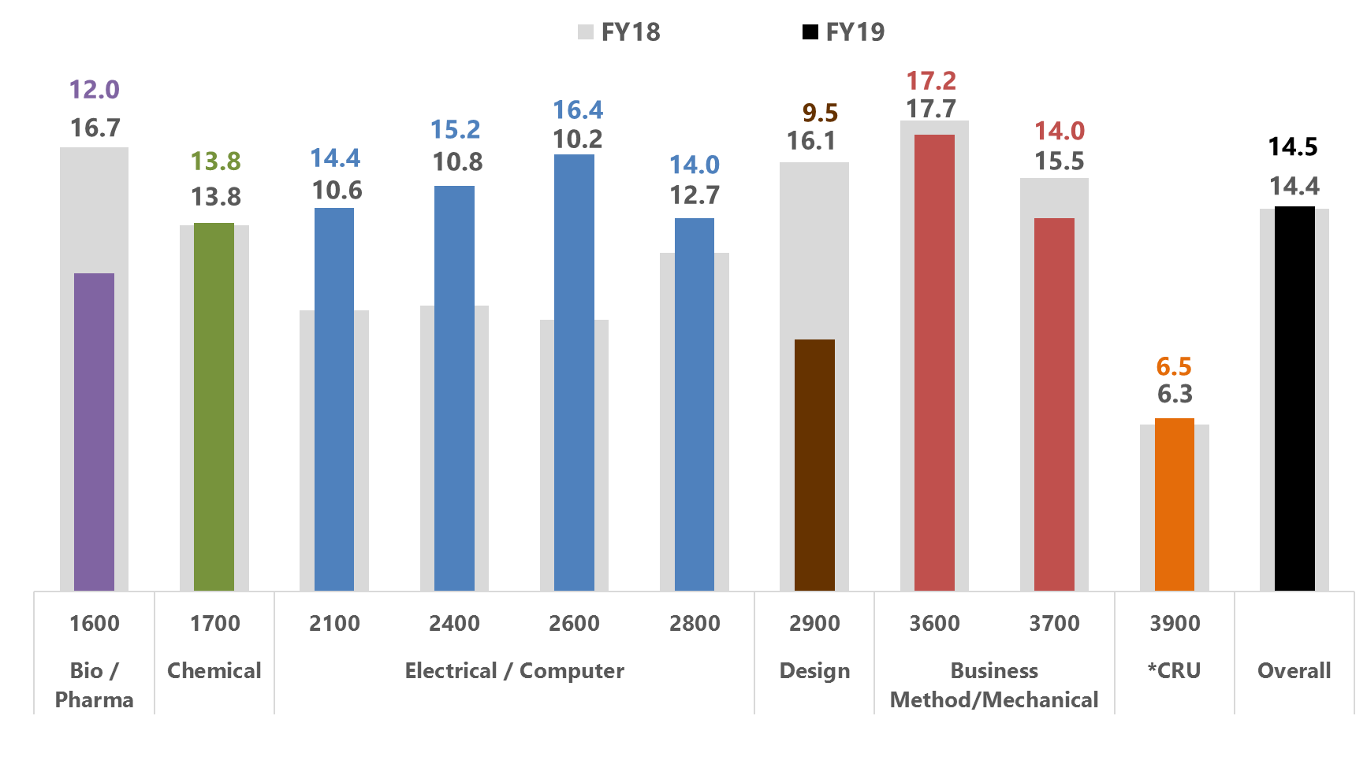
Pendency of decided appeals in FY18 and FY19 (Jul. – Sept. FY18 compared to Jul. – Sept. FY19)
Pendency is calculated as average months from Board receipt date to final decision.
Pendency is calculated for a three month period compared to the same period the previous year.
*CRU (Central Reexamination Unit) decisions include ex parte reexam, inter partes reexam, supplemental examination review, and reissues from all technologies.

Slide 5
Appeal intake in FY19 (Oct. 1, 2018 – Sept. 30, 2019)
*The Central Reexamination Unit includes ex parte reexams, inter partes reexams, supplemental examination reviews and reissues from all technologies.

Slide 6
Appeal outcomes in FY19 (Oct. 1, 2018 – Sept. 30, 2019)

Slide 7
Interference inventory (Sept. 30, 2008 – Sept. 30, 2019)

Slide 8
Trial statistics
September 2019

Slide 9
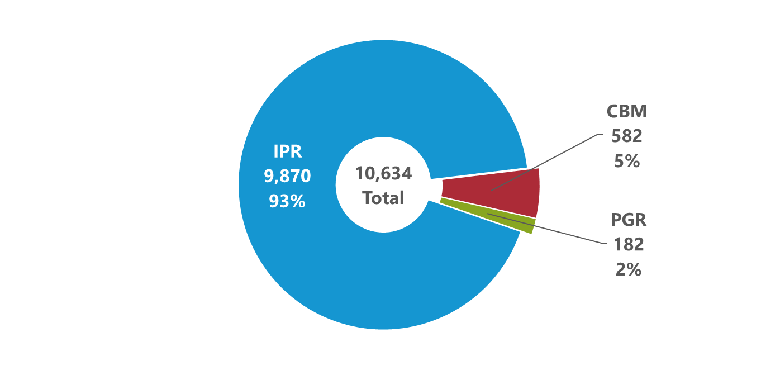
Petitions by trial type (All time: Sept. 16, 2012 – Sept. 30, 2019)
Trial types include Inter Partes Review (IPR), Post Grant Review (PGR), and Covered Business Method (CBM).

Slide 10
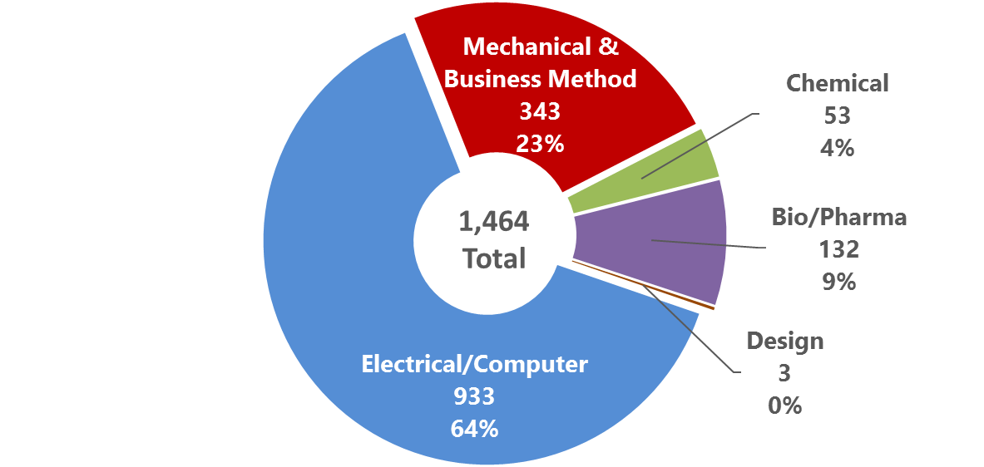
Petitions filed by technology in FY19 (FY19: Oct. 1, 2018 – Sept. 30, 2019)

Slide 11
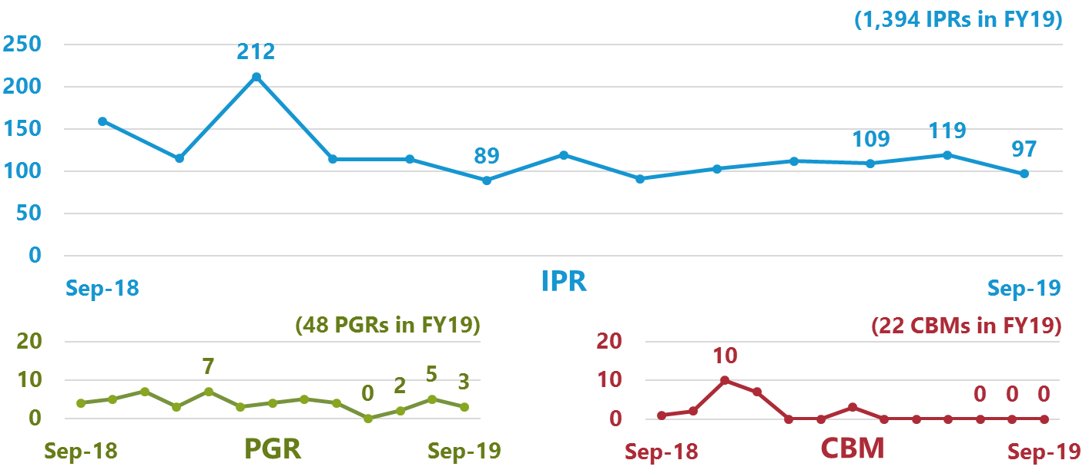
Petitions filed by month (Sept. 2019 and previous 12 months: Sept. 1, 2018 – Sept. 30, 2019)

Slide 12
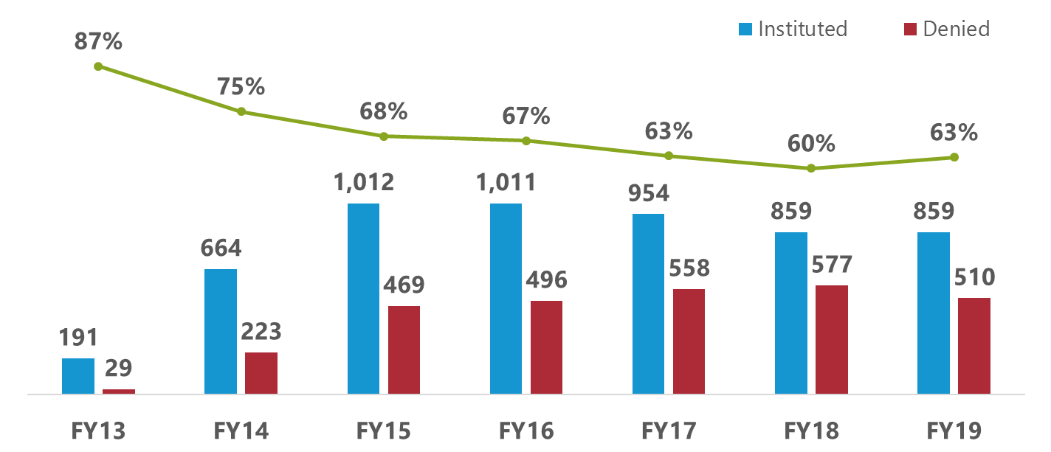
Institution rates (FY13 to FY19: Oct. 1, 2012 – Sept. 30, 2019)
Institution rate for each fiscal year is calculated by dividing petitions instituted by decisions on institution (i.e., petitions instituted plus petitions denied). The outcomes of decisions on institution responsive to requests for rehearing are excluded.

Slide 13
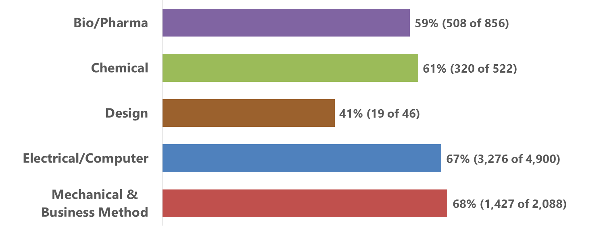
Institution rates by technology (All Time: Sept. 16, 2012 – Sept. 30, 2019)
Institution rate for each technology is calculated by dividing petitions instituted by decisions on institution (i.e., petitions instituted plus petitions denied). The outcomes of decisions on institution responsive to requests for rehearing are excluded.

Slide 14
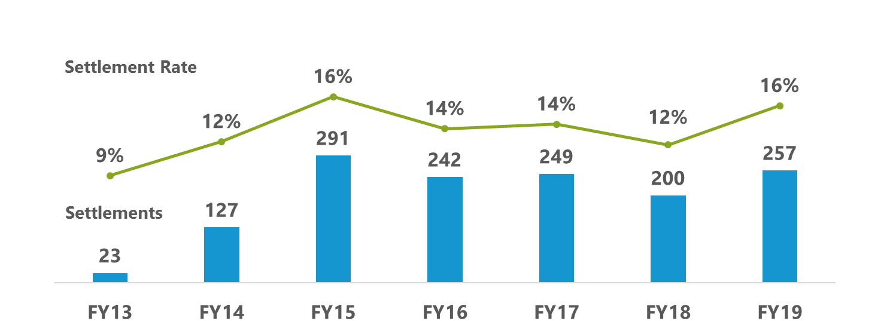
Pre-institution settlements (FY13 to FY19: Oct. 1, 2012 – Sept. 30, 2019)
Settlement rate for each year is calculated by dividing pre-institution settlements by the sum of proceedings instituted, denied institution, dismissed, terminated with a request for adverse judgment, and settled before decision on institution.

Slide 15
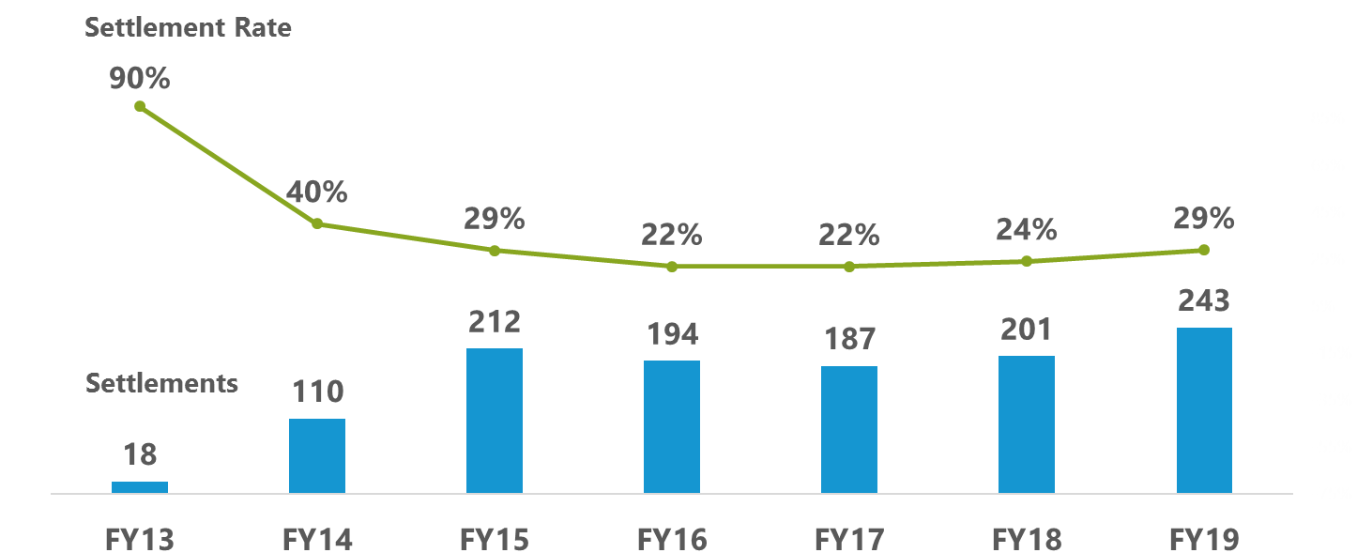
Post-institution settlements (FY13 to FY19: Oct. 1, 2012 – Sept. 30, 2019)
Settlement rate for each year is calculated by dividing post-institution settlements by proceedings terminated post-institution (i.e., settled, dismissed, terminated with a request for adverse judgment, and final written decision), excluding joined cases.

Slide 16
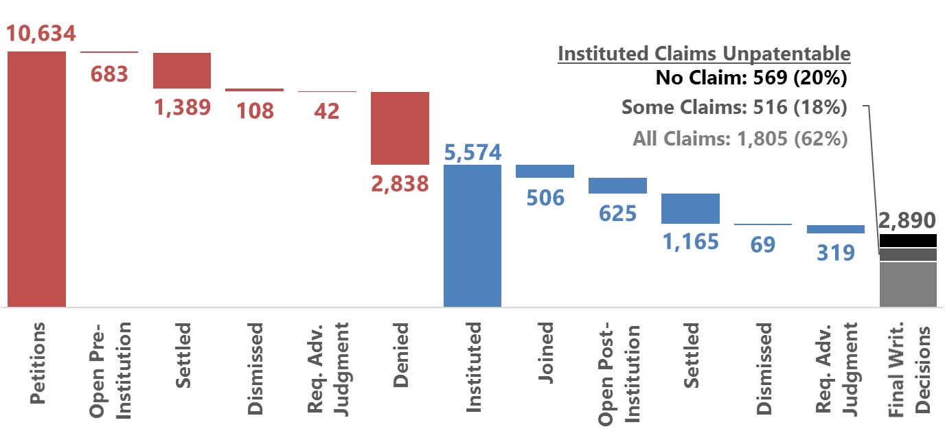
Status of petitions (All Time: Sept. 16, 2012 – Sept. 30, 2019)
These figures reflect the latest status of each petition. The outcomes of decisions on institution responsive to requests for rehearing are incorporated. Once joined to a base case, a petition remains in the Joined category regardless of subsequent outcomes.

Slide 17
POP cases

Slide 18
Standard operating procedure 2 September 2018 update
Provides new Precedential Opinion Panel (POP) for creating binding Board precedent on rehearing
Provides notice to the parties when POP review takes place, as well as the identification of the POP members in a particular case
Explains the standards, procedures, and timing for requesting POP review in a pending case on rehearing
Provides for designation and de-designation of precedential opinions by the director

Slide 19
Precedential Opinion Panel (POP)
Outlined in PTAB standard operating procedure 2 (SOP2), available at go.usa.gov/xPMqx
Criteria:
Constitutional questions
Important questions regarding statutes, rules, regulations
Important issues regarding precedential case law
Issues of broad applicability to Board
Resolve conflicts between Board decisions
Promote certainty and consistency

Slide 20
Precedential Opinion Panel (POP)
Default composition
Director
Commissioner for patents
PTAB chief judge
Issued first decision on March 13, 2019
Proppant Express Investments v. Oren Technologies, Case IPR2018-00914 (PTAB March 13, 2019) (Paper 38)

Slide 21
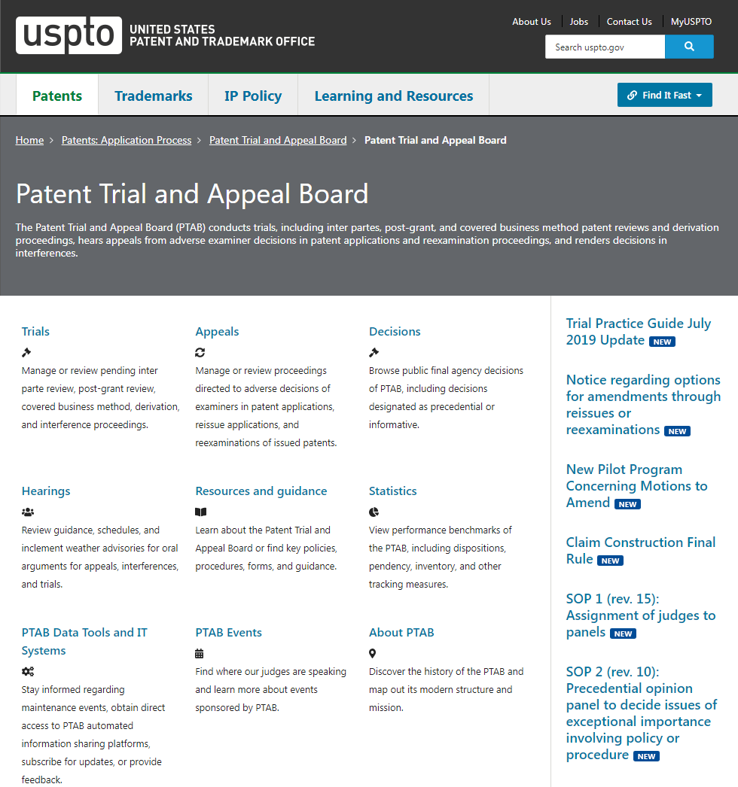
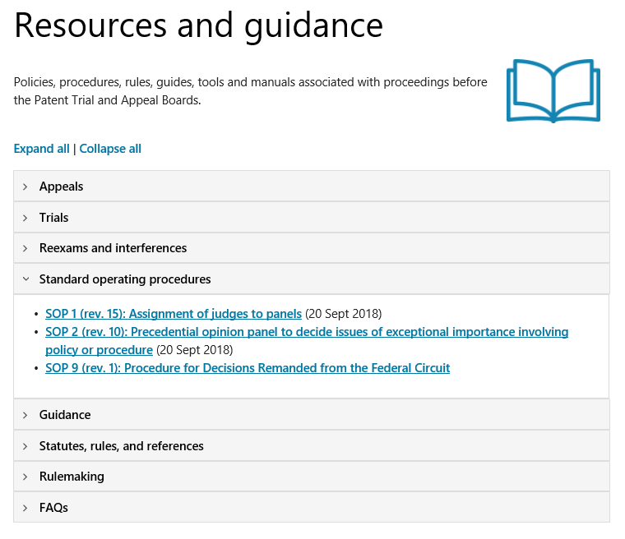
Standard operating procedure 2

Slide 22
POP decisions and orders
Case/appeal name | Case/appeal number | Topic | Status | Date decided
Proppant Express Invs., LLC v. Oren Techs., LLC | IPR2018-00914, Paper 38 | AIA - Joinder - 315(c) | Decided (POP) | 3/13/2019
GoPro, Inc. v. 360Heros, Inc. | IPR2018-01754, Paper 23 | AIA - 315(b) - Time Bar | Decided (POP) | 8/23/2019
Case/appeal name | Case/appeal number | Topic | Status | Date order issued
Hulu, LLC v. Sound View Innovations, LLC | IPR2018-01039, Paper 15 | AIA - Printed Publications | Pending (POP) | 4/3/2019

Slide 23
GoPro, Inc. v. 360Heros, Inc.
IPR2018-01754 (PTAB Aug. 23, 2019) (Paper 38)
Precedential Opinion Panel (POP) ordered review to address the following issue:
Whether the service of a pleading asserting a claim alleging infringement, where the serving party lacks standing to sue or the pleading is otherwise deficient, triggers the one-year time period for a petitioner to file a petition under 35 U.S.C. § 315(b).
The POP accepted additional briefing from the parties and amici and held an oral hearing on June 25, 2019. The POP issued a precedential decision on Aug. 23, 2019.

Slide 24
GoPro, Inc. v. 360Heros, Inc.
IPR2018-01754 (PTAB Aug. 23, 2019) (Paper 38)
The POP concluded:
“Served with a complaint alleging infringement” in 35 U.S.C. § 315(b) is plain and unambiguous.
The service of a pleading asserting a claim alleging infringement triggers the one-year time period for a petitioner to file a petition under 35 U.S.C. § 315(b), regardless of whether the serving party lacked standing to sue or the pleading was otherwise deficient.

Slide 25
Hulu, LLC v. Sound View Innovations, LLC
IPR2018-01039 (PTAB April 3, 2019) (Paper 15)
Precedential Opinion Panel (POP) ordered review to address the following issue:
What is required for a petitioner to establish that an asserted reference qualifies as “printed publication” at the institution stage?
Oral hearing held on June 18, 2019

Slide 26
Recent precedential decisions

Slide 27
PTAB decisions www.uspto.gov/patents-application-process/patent-trial-and-appeal-board/decisions

Slide 28
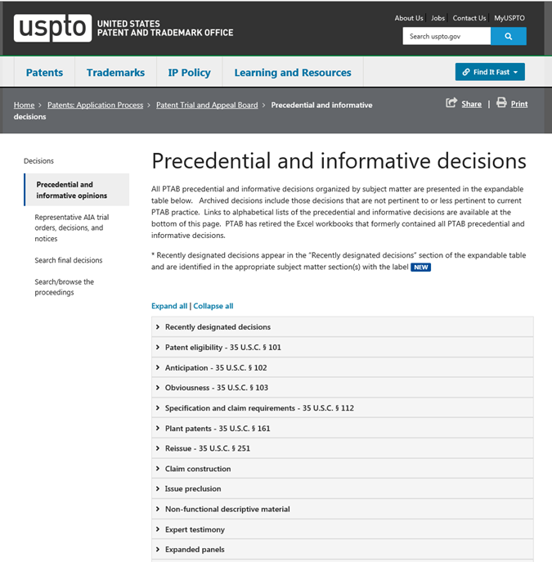
Precedential and informative decisions www.uspto.gov/patents-application-process/patent-trial-and-appeal-board/precedential-informative-decisions

Slide 29
Recent precedential and informative decisions
Precedential decisions (16)
Informative decisions (8)
AIA - RPI - 312(a)(2), 315(b) (2)
AIA - RPI - 322(a)(2) (1)
AIA - Institution - 314(a) (2)
AIA - Institution - 314(a), 325(d) (1)
AIA - Institution - 325(d) (1)
AIA - Bar - 315(a)(1) (1)
AIA - Time Bar - 315(b) (1)
AIA - MTA - 316(d) (2)
AIA - Oral Argument (2)
AIA - Pre-institutions Disclaimer (1)
AIA - Request for Rehearing (1)
AIA - Witness Testimony (1)
AIA - Institution - 312(a)(3) (1)
AIA - Institution - 314(a) (2)
101 (5)

Slide 30
Recent decisions designated precedential
Case/appeal name | Case/appeal number | Topic | Date issued | Date designated
Proppant Express Invs., LLC v. Oren Techs., LLC | IPR2017-01917, Paper 86 | AIA - RPI - 312(a)(2), 315(b) | 2/13/2019 | 4/16/2019
Ventex Co., Ltd. v. Columbia Sportswear North America, Inc. | IPR2017-00651, Paper 152 | AIA - RPI - 312(a)(2), 315(b) | 1/24/2019 | 4/16/2019
Infiltrator Water Techs., LLC v. Presby Patent Trust | IPR2018-00224, Paper 25 | AIA - Time Bar - 315(b) | 10/1/2018 | 9/9/2019
Adello Biologics, LLC v. Amgen, Inc. | PGR2019-00001, Paper 11 | AIA - RPI - 322(a)(2) | 2/14/2019 | 4/16/2019
Valve Corp. v. Elec. Scripting Prods., Inc. | IPR2019-00062, -00063, -00084, Paper 11 | AIA - Institution - 314(a) | 4/2/2019 | 5/7/2019
Valve Corp. v. Elec. Scripting Prods., Inc. | IPR2019-00064, -00065, -00085, Paper 10 | AIA - Institution - 314(a) | 5/1/2019 | 8/2/2019
NHK Spring Co., Ltd. v. Intri-Plex Techs., Inc. | IPR2018-00752 , Paper 8 | AIA - Institution - 314(a), 325(d) | 9/12/2018 | 5/7/2019
Becton, Dickinson and Company v. B. Braun Melsungen AG | IPR2017-01586, Paper 8 | AIA - Institution - 325(d) | 12/15/2017 | 8/2/2019
Cisco Systems, Inc. v. Chrimar Systems, Inc. | IPR2018-01511, Paper 11 | AIA - Institution -315(a)(1) | 1/31/2019 | 8/29/2019

Slide 31
Recent decisions designated precedential (cont.)
Case/appeal name | Case/appeal number | Topic | Date issued | Date designated
Lectrosonics, Inc. v. Zaxcom, Inc. | IPR2018-01129, -01130, Paper 15 | AIA - MTA - 316(d) | 2/25/2019 | 3/7/2019
Amazon.com, Inc. v. Uniloc Luxembourg S.A. | IPR2017-00948, Paper 34 | AIA - MTA - 316(d) | 1/18/2019 | 3/18/2019
General Electric Co. v. United Techs. Corp. | IPR2017-00491, Paper 9 | AIA - Statutory Disclaimer | 7/6/2017 | 9/9/2019
DePuy Synthes Prods., Inc. v. MEDIDEA, LLC | IPR2018-00315, Paper 29 | AIA - Oral Argument | 1/23/2019 | 3/18/2019
K-40 Elecs., LLC v. Escort, Inc. | IPR2013-00203, Paper 34 | AIA - Oral Argument | 5/21/2014 | 3/18/2019
Huawei Device Co., Ltd. v. Optis Wireless Tech., LLC | IPR2018-00816, Paper 19 | AIA - Request for Rehearing | 1/8/2019 | 4/5/2019
Focal Therapeutics, Inc. v. SenoRx, Inc. | IPR2014-00116, Paper 19 | AIA - Depositions | 7/21/2014 | 7/10/2019

Slide 32
Cisco Systems, Inc. v. Chrimar Systems, Inc.
IPR2018-01511 (PTAB Jan. 31, 2019) (Paper 11) (Precedential)
Designated precedential on Aug. 29, 2019.
Denied institution under 35 U.S.C. § 315(a)(1) after applying Click-to-Call Technologies, LP v. Ingenio, Inc., 899 F.3d 1321 (Fed. Cir. Aug. 16, 2018).
Determined that § 315(a)(1) bars institution of an inter partes review of a patent where petitioner voluntarily dismissed its earlier civil action challenging the validity of that patent. Explained that denial is appropriate because:
§ 315(a)(1) does not include an exception for a civil action that was dismissed without prejudice and Congress knew how to, but did not provide such an exception.
The ordinary meanings of the terms “file” and “civil action” show that the phrase “filed a civil action” in § 315(a)(1) applies to a civil action that was dismissed without prejudice.

Slide 33
Valve Corporation v. Electronic Scripting Products, Inc.
IPR2019-00064, -00065, -00085 (PTAB May 1, 2019) (Paper 10) (Precedential)
Designated precedential on Aug. 2, 2019.
Denied institution under 35 U.S.C. § 314(a), after applying the General Plastic factors.
Determined that the first General Plastic factor (“whether the same petitioner previously filed a petition directed to the same claims of the same patent”) applies to petitioner because petitioner joined a previously instituted inter partes review proceeding and, therefore, is considered to have previously filed a petition directed to the same claims of the same patent.
Explained that the Board’s application of the General Plastic factors is not limited to instances in which a single petitioner has filed multiple petitions.

Slide 34
Becton, Dickinson and Company v. B. Braun Melsungen AG
IPR2017-01586 (PTAB Dec. 15, 2017) (Paper 8) (Precedential as to the first paragraph of Section III.C.5 only; Informative for the rest)
Designated informative on March 21, 2018.
Designated precedential on Aug. 2, 2019, as to the first paragraph of Section III.C.5 only.
The first paragraph of Section III.C.5 identifies six non-exclusive factors that the Board considers in evaluating whether to exercise discretion, under 35 U.S.C. § 325(d), when a petition includes the same or substantially the same prior art or arguments that previously were presented to the office, such as:
the similarities and material differences between the asserted art and the prior art involved during examination;
the cumulative nature of the asserted art and the prior art evaluated during examination;
the extent to which the asserted art was evaluated during examination, including whether the prior art was the basis for rejection;
the extent of the overlap between the arguments made during examination and the manner in which petitioner relies on the prior art or patent owner distinguishes the prior art;
whether petitioner has pointed out sufficiently how the examiner erred in his/her evaluation of the asserted prior art; and
the extent to which additional evidence and facts presented in the petition warrant reconsideration of the prior art or arguments.

Slide 35
Focal Therapeutics, Inc. v. SenoRx, Inc.
IPR2014-00116 (PTAB July 21, 2014) (Paper 19) (Precedential)
Designated precedential on July 10, 2019.
Clarified the Board’s Testimony Guidelines set forth in the Patent Trial Practice Guide at 77 Fed. Reg. 48756, 48772-48773 (Aug. 14, 2012) that provides:
Once the cross-examination of a witness has commenced, and until cross-examination of the witness has concluded, counsel offering the witness on direct examination shall not: (a) consult or confer with the witness regarding the substance of the witness’s testimony already given, or anticipated to be given, except for the purpose of conferring on whether to assert a privilege against testifying or on how to comply with a Board order; or (b) suggest to the witness the manner in which any questions should be answered.
Clarified that the prohibition of conferring with the witness ends once cross-examination concludes, and, if relevant, begins again when re-cross commences, and continues until re-cross concludes.

Slide 36
Recent informative decisions

Slide 37
Recent decisions designated informative
Case/appeal name | Case/appeal number | Topic | Date issued | Date designated
Adaptics Limited v. Perfect Company | IPR2018-01596, Paper 20 | AIA - Grounds - 312(a)(3) | 3/6/2019 | 8/2/2019
Deeper, UAB v. Vexilar, Inc. | IPR2018-01310, Paper 7 | AIA - Institution - 314(a) | 1/24/2019 | 4/5/2019
Chevron Oronite Company LLC v. Infineum USA LP | IPR2018-00923, Paper 9 | AIA - Institution - 314(a) | 11/7/2018 | 4/5/2019
Ex Parte Smith | 2018-000064 | 101 | 2/1/2019 | 3/19/2019
Ex Parte Olson | Appeal 2017-006489 | 101 | 3/25/2019 | 7/1/2019
Ex Parte Kimizuka | Appeal 2018-001081 | 101 | 5/15/2019 | 7/1/2019
Ex Parte Savescu | Appeal 2018-003174 | 101 | 4/1/2019 | 7/1/2019
Ex Parte Fautz | Appeal 2019-000106 | 101 | 5/15/2019 | 7/1/2019

Slide 38
Recent decisions designated informative
Case/Appeal Name | Case/Appeal Number | Topic | Date Issued | Date Designated
Ex Parte Maeda | Appeal 2010-009814 | Design Choice - 103 | 10/23/2012 | 10/15/2019
Ex Parte Spangler | Appeal 2018-003800 | Design Choice - 103 | 2/20/2019 | 10/15/2019

Slide 39
Adaptics Limited v. Perfect Company
IPR2018-01596 (PTAB March 6, 2019) (Paper 20)
Designated informative on Aug. 2, 2019.
Denied institution based on 35 U.S.C. § 312(a)(3).
Determined the petition lacks particularity in its identification of its asserted challenges that results in voluminous and excessive grounds.
Determined the entire petition should be denied, weighing the interests of the efficient administration of the office, the integrity of the patent system, and procedural fairness to the patent owner.

Slide 40
Ex Parte Fautz
Appeal 2019-000106 (PTAB May 15, 2019) (Informative)
Designated informative on July 1, 2019.
Recited claims are directed to magnetic resonance tomography.
Applied the revised guidance published in the USPTO’s Jan. 7, 2019, memorandum, 2019 Revised Patent Subject Matter Eligibility Guidance.
Concluded that the claims recite a judicial exception, a mathematical concept, but that the claims recite additional elements that integrate the judicial exception into a practical application.

Slide 41
Ex Parte Olson
Appeal 2017-006489 (PTAB March 25, 2019) (Informative)
Designated informative on July 1, 2019.
Recited claims are directed to a catheter navigation system.
Applied the revised guidance published in the USPTO’s Jan. 7, 2019, memorandum, 2019 Revised Patent Subject Matter Eligibility Guidance.
Concluded that the claims recite a judicial exception, a mathematical concept, but that the claims recite additional elements that integrate the judicial exception into a practical application.

Slide 42
Ex Parte Kimizuka
Appeal 2018-001081 (PTAB May 15, 2019) (Informative)
Designated informative on July 1, 2019.
Recited claims are directed to a golf-club fitting method.
Applied the revised guidance published in the USPTO’s Jan. 7, 2019, memorandum, 2019 Revised Patent Subject Matter Eligibility Guidance.
Concluded that the claims recite a judicial exception, a mental process, and determined that the claims do not integrate the exception into a practical application or provide an inventive concept.

Slide 43
Ex Parte Savescu
Appeal 2018-003174 (PTAB April 1, 2019) (Informative)
Designated informative on July 1, 2019.
Recited claims are directed to a life-cycle workflow method.
Applied the revised guidance published in the USPTO’s Jan. 7, 2019, memorandum, 2019 Revised Patent Subject Matter Eligibility Guidance.
Concluded that the claims recite a judicial exception, a method of organizing human activity, and determined that the claims do not integrate the exception into a practical application or provide an inventive concept.

Slide 44
Ex Parte Maeda
Appeal 2010-009814 (PTAB Oct. 23, 2012) (Informative)
Designated informative on October 15, 2019.
Determined that the location of a claimed component of a manufacturing apparatus was a matter of obvious design choice because moving the component to the claimed location would result in a different function than shown in the prior art.

Slide 45
Ex Parte Spangler
Appeal 2018-003800 (PTAB Feb. 20, 2019) (Informative)
Designated informative on October 15, 2019.
Determined that claimed relative lengths and locations of two claimed components were a matter of obvious design choice because the specification did not suggest that the relative lengths or locations were critical to the claimed invention.

Slide 46
MTA pilot program status

Slide 47
Request for comment on proposed changes to motion to amend (MTA) practice in AIA trials
Oct. 29, 2018, motion to amend (MTA) request for comments (RFC).
Proposed a new MTA process and pilot program.
Sought input regarding burden of persuasion when determining patentability of substitute claims, after Aqua Products.
Included 17 questions of interest, but also solicited feedback regarding MTA practice generally.
Office received 49 comments from stakeholders (as of Dec. 21, 2018).
Office carefully considered all comments and revised pilot program in response.

Slide 48
MTA pilot program notice
In response to comments, the office issued a notice regarding a new pilot program concerning MTA practice and procedures in AIA trials.
Published in Federal Register at 84 Fed. Reg. 9497 (March 15, 2019).
Notice also provides responses to comments.
Topics include timelines, retroactivity of applying pilot, Board preliminary decision, opportunity to file a revised MTA, contingent MTAs, and opting-out of pilot.
Comments also included requests for clarification regarding existing reissue and reexamination procedures at the USPTO.
Stakeholder comments to October MTA RFC are available at go.usa.gov/xEXS2.

Slide 49
Highlights of MTA pilot program
New program provides patent owner (PO) with two options not previously available:
PO may choose to receive preliminary guidance (PG) from Board on its MTA.
PO may choose to file a revised MTA after receiving petitioner’s opposition to initial MTA and/or after receiving Board’s PG (if requested).

Slide 50
Highlights of MTA pilot program
If PO does not elect either option:
AIA trial practice, including MTA procedure, is essentially unchanged from prior practice, especially regarding timing of due dates for already existing papers in an AIA trial.
One small exception: times between due dates for certain later-filed papers are extended slightly.

Slide 51
Highlights of MTA pilot program
Upon institution of an AIA trial, Board will issue the same scheduling order in every case.
Due dates are similar to prior practice.
Due dates are calculated in weeks.
If PO chooses to file a revised MTA after receiving petitioner’s opposition and Board’s PG (if requested), Board will issue a revised scheduling order soon thereafter.

Slide 52
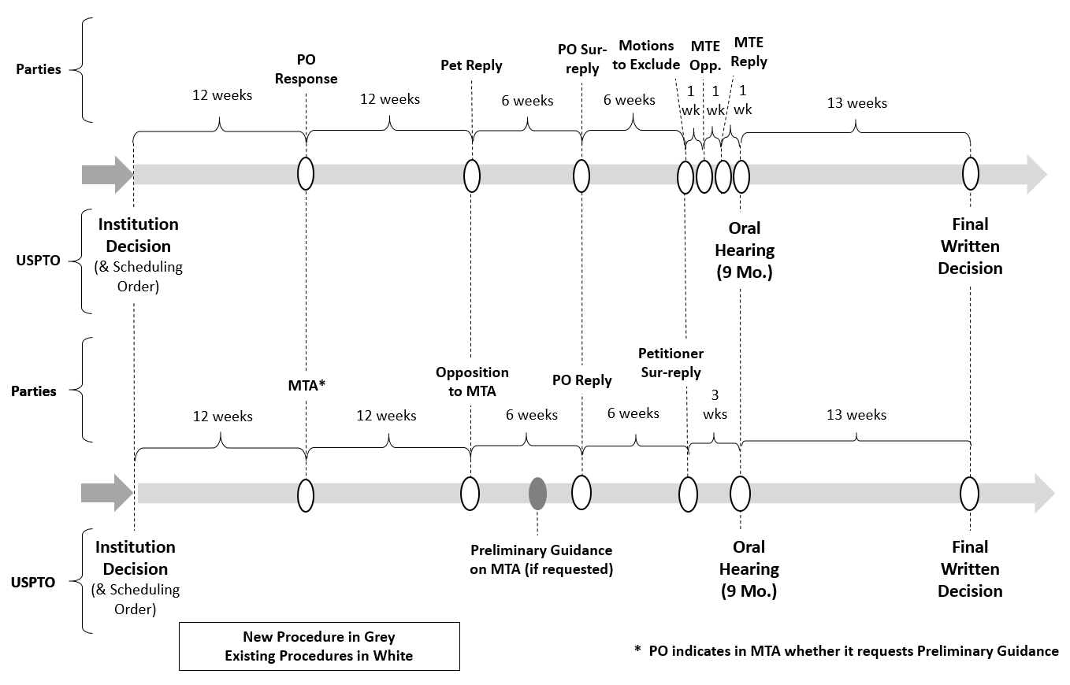
Schedule entered at institution (Appendix 1A)

Slide 53
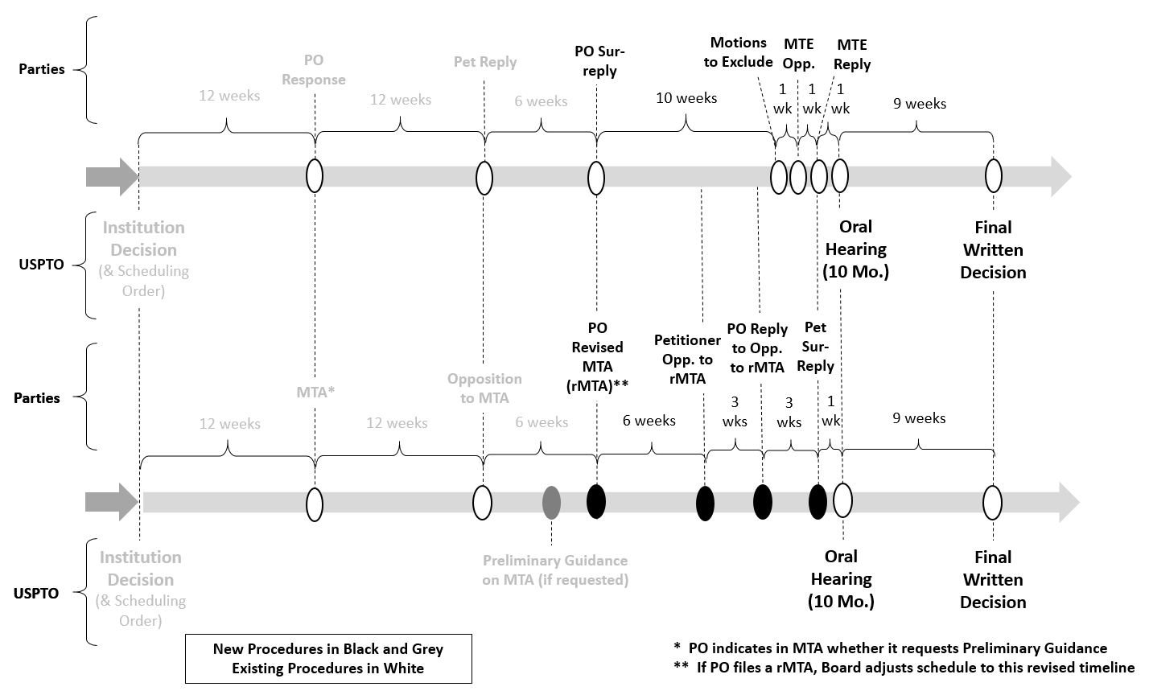
Revised schedule if revised MTA (Appendix 1B)

Slide 54
Highlights of MTA pilot program
MTA and revised MTA are contingent unless PO indicates otherwise, e.g., by canceling original claims.
If PO does not request PG in initial MTA, no PG.
Changes if/after PO files a revised MTA:
One additional paper for each party.
New briefing and oral hearing schedule to accommodate.
Final written decision addresses only substitute claims at issue in latest filed MTA.

Slide 55
Pilot program implementation
Effective date is publication date of notice (March 15, 2019).
Applies to all AIA trials instituted on or after that date.
USPTO anticipates it will reassess pilot program approximately one year from effective date.
Potentially may terminate program at any time or continue program (with or without modifications) depending on stakeholder feedback and effectiveness of program.

Slide 56
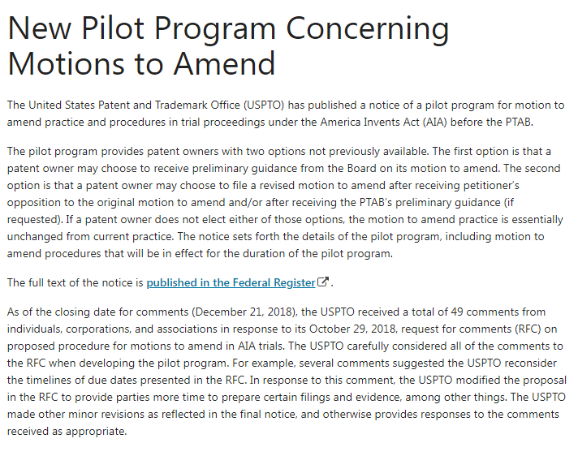
MTA pilot program www.uspto.gov/patents-application-process/patent-trial-and-appeal-board/new-pilot-program-concerning-motions

Slide 57
Notice regarding options for amendments through reissue or reexamination during pending AIA proceeding

Slide 58
Notice regarding options for reissue or reexamination during pending AIA proceeding
Published in Federal Register at 84 Fed. Reg. 16654 (April 22, 2019).
Notice provides:
A summary of current practice regarding existing USPTO procedures that apply to reissue and reexamination, including after a petitioner files an AIA petition challenging claims of same patent, after Board institutes a trial, and after Board issues a final written decision (FWD).
Summary information about factors currently considered when determining:
Whether to stay or suspend a reissue proceeding, or stay a reexamination proceeding, that involves a patent at issue in an AIA proceeding; and
When and whether to lift such a stay or suspension.

Slide 59
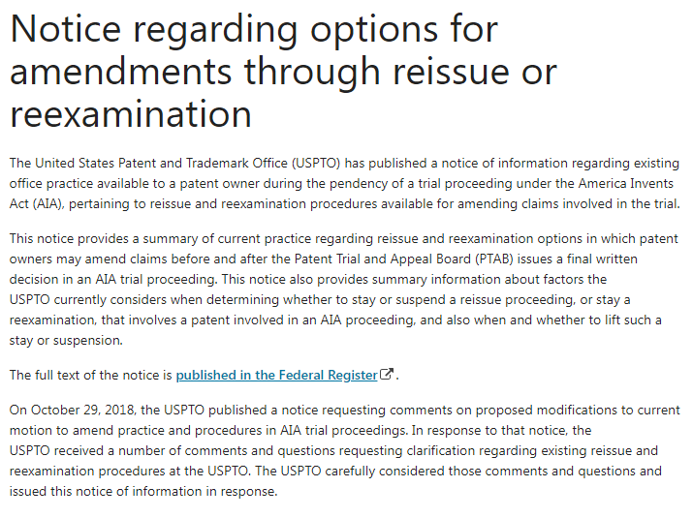
Options for amendments on PTAB www.uspto.gov/patents-application-process/patent-trial-and-appeal-board/notice-regarding-options-amendments

Slide 60
Trial practice guide
July 2019 update

Slide 61
Trial practice guide, July 2019 update
Guidance in the July 2019 update includes:
Factors that may be considered by the Board in determining when additional discovery will be granted.
The revised claim construction standard to be used in IPR, PGR, and CBM proceedings.
The submission of testimonial evidence with a patent owner preliminary response.
Information to be provided by the parties if there are multiple petitions filed at or about the same time challenging the same patent.
Motion to amend practice.
Factors that may be considered by the Board in determining whether to grant a motion for joinder.
Procedures to be followed when a case is remanded.
Procedures for parties to request modifications to the default protective order.

Slide 62
Trial practice guide update on PTAB webpage www.uspto.gov/patents-application-process/patent-trial-and-appeal-board/trial-practice-guide-july-2019-update

Slide 63
Notice of Proposed Rulemaking
Burdens for motion to amend

Slide 64
Notice of Proposed Rulemaking on allocation of burdens for motion to amend
Published October 22, 2019
Proposes
petitioner bears the burden to show the unpatentability of substitute claims proposed in a motion to amend;
patent owner bears the burden to show that a motion to amend complies with certain statutory and regulatory requirements; and
the Board may, in the interests of justice, make a determination regarding the patentability of substitute claims based on the record in the proceeding regardless of the burdens assigned to any party.
Comments due December 23, 2019

Slide 65
Scott R. Boalick
Chief administrative patent judge
scott.boalick@uspto.gov
571-272-9797

