Slide 1
PTAB Litigation 2016 Part 7 – Petitioner Reply and Motion to Exclude

Slide 2
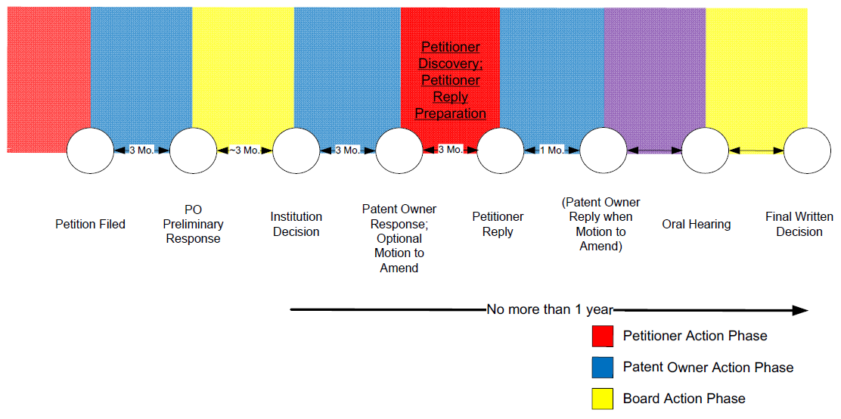
Petitioner Discovery, Reply

Slide 3
Petitioner Discovery
Petitioner discovery period begins about 20 days after Patent Owner Response and ends one week before Petitioner Reply is due;
Petitioner is entitled to deposition of any patent owner expert by right;
Other discovery only by agreement of parties or Board order (e.g., via motion).

Slide 4
Petitioner Discovery
Cross Examination of Patent Owner’s Expert
Timing:
Begins after supplemental evidence due – about 20 days after Patent Owner Response;
Ends week before Petitioner Reply (Rule 42.53(d)(2));
Guidelines in Trial Practice Guide;
Strategy:
Targeted admissions to poke holes in declaration;
Prevent supplementing of declaration:
Trial cross examination style (contrast with fact discovery).

Slide 5
Petitioner Reply
Include statement identifying material facts in dispute;
Must address all disputes with patent owner response:
“Any material fact not specifically denied may be considered admitted” (Rule 42.23(a));
And only those disputes:
“A reply may only respond to arguments raised in the corresponding opposition or patent owner response” (Rule 42.23(b));
Added firepower over Petition
Can bolster with additional expert declaration (preferably not “expertization” of reply), but will subject to additional deposition (Rules 42.51(b)(1)(ii), 42.53(d)(2)).

Slide 6
Petitioner Reply
Respond to all attacks on procedure and substance;
Litigation quality rebuttal expert report
All opinions must be supported with evidence;
All opinions must be in rebuttal to patent owner response;
Lay groundwork for oral hearing
Integrate demonstratives into reply;
Dismantle patent owner’s expert – include deposition admissions;
Challenge nexus for secondary considerations.

Slide 7
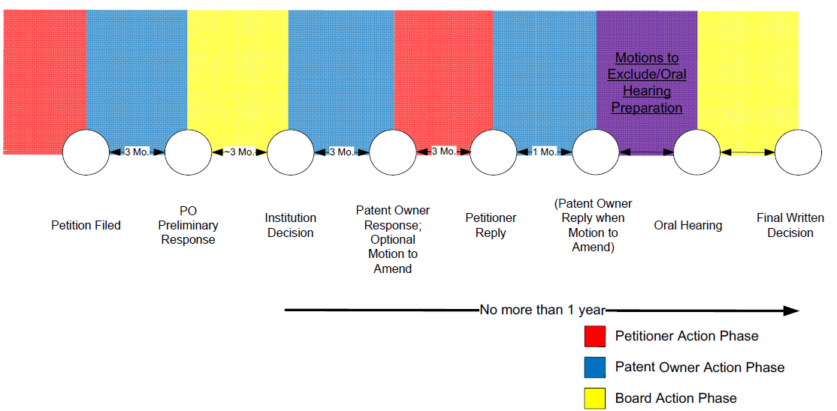
Evidence Objections – Motions to Exclude

Slide 8
Evidentiary Issues
Federal Rules of Evidence generally apply (Rule 42.62(a));
Process must be followed to request exclusion of improper evidence:
Make timely objection to evidence (Rule 42.64);
Other party has opportunity to cure via supplemental evidence within 10 days (Rule 42.64(b)(2));
File Motion to Exclude in latter part of trial (Rule 42.64(c));
No leave necessary to file Motion to Exclude – Included in initial scheduling order.

Slide 9
Objections to Evidence (Rule 42.64)
Depositions:
Must raise objections during deposition;
Evidence to cure must be provided during deposition (e.g., rephrasing the question), unless parties stipulate on record;
Non-deposition evidence:
Evidence from preliminary phase: serve objections within 10 business days of trial institution;
Evidence presented after institution: serve objections within 5 business days of objectionable evidence;
May respond to objection with supplemental evidence within 10 days of objection;
Motion to exclude: necessary to preserve objection – must reference a previously made objection.

Slide 10
Motions to Exclude
Success rates are about 5%;
Somewhat misleading, as Board will find many motions moot when issue does not affect outcome;
Can make for appealable issue, so some are worth making;
Especially for egregious conduct;
Failure to disclose evidence in timely manner Corning Inc. v. DSM IP Assets B.V., IPR2013-00052; The Scotts Co. LLC v. Encap, LLC, IPR2013-00110;
Failure to provide documents referenced in declaration in English Zodiac Pool Systems, Inc. v. Aqua Products, Inc, IPR2013-00159.

Slide 11
Motions to Exclude
Typically Unsuccessful Motions;
Motions for minor flaws or issues that go to weight of evidence, not overall exclusion;
e.g., Expert not qualified to opine – might still make motion as it gives extra pages to downplay the expert’s qualifications;
Also argue weight of evidence in formal papers, such as patent owner response and petitioner reply;

