Slide 1
PTAB Litigation 2016 Part 2 – The Petition

Slide 2
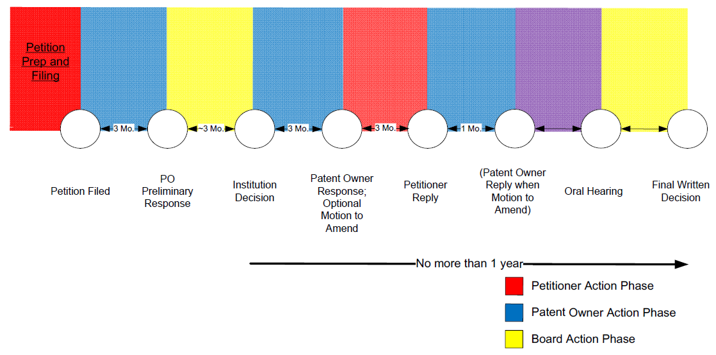
The Petition

Slide 3
The Petition
PTAB trials begin with a petition requesting that the Board review the patentability of an issued patent.
Each of the different types of PTAB trials (i.e., IPR, CBM, PGR) includes restrictions on who can file petitions for review and when such petitions can be filed. CBM trials are further limited as to the types of patents that can be challenged.
These standing and other restrictions typically drive trial type selection strategy.

Slide 4
Standing Requirements - IPRs
IPR Standing Requirements
1 year bar: IPR petition must be filed within 1 year of service of complaint alleging infringement.
Declaratory judgment bar: IPR petition must be filed prior to DJ action on invalidity.
PGR bar: Cannot file IPR petition within first 9 months after grant of patent having earliest priority on or after March 16, 2013.

Slide 5
IPR Standing Requirements
Standing Requirements
1 year bar:
35 U.S.C. § 315(b): “An inter partes review may not be instituted if the petition requesting the proceeding is filed more than 1 year after the date on which the petitioner, real party in interest, or privy of the petitioner is served with a complaint alleging infringement of the patent. The time limitation set forth in the preceding sentence shall not apply to a request for joinder under subsection (c).” See 37 C.F.R. § 42.101(b).
Refers to earliest complaint in case not dismissed without prejudice (i.e., a second complaint on same patent does not revive ability to file IPR petition) LG Electronics v. Mondis Tech., IPR2015-00937.

Slide 6
IPR Standing Requirements
Standing Requirements
Declaratory judgment bar:
“An inter partes review may not be instituted if, before the date on which the petition for such a review is filed, the petitioner or real party in interest filed a civil action challenging the validity of a claim of the patent.” 35 U.S.C. § 315(a)(1); see 37 C.F.R. § 42.101(a) (implementing as Rule 42.101(a).
Exceptions:
Dismissal without prejudice of prior DJ action does not bar IPR. In re P&G Co., 749 F.3d 1376, 1379 (Fed. Cir. 2014) (denying mandamus petition challenging IPR institution).
Civil action seeking DJ of non-infringement, but not invalidity, does not bar IPR.

Slide 7
IPR Standing Requirements
Standing Requirements
Post-Grant Review Bar:
37 C.F.R. § 42.102:
(a)(1) First inventor to file patents (i.e., patents having priority dates on or after March 16, 2013) are not eligible for IPR petitions until 9 months after grant date. During this period, PGR is available.
(a)(2) First to invent patents are eligible for IPR petitions on their grant date.

Slide 8
The Petition
Substantive Content of Petition
(a) Certification of standing;
(b) Identification of challenge:
(1) Claims;
(2) Grounds (§§ 102 or 103);
(3) Constructions (*including § 112(f) means-plus-function);
(4) Prior art mapping to claim(s) (charts);
(5) Evidence (prior art citations and relevance);
(37 C.F.R. § 42.104.)

Slide 9
The Petition
Formal Requirements:
60 page limit;
Double-spaced (except claim charts, headings);
Portrait-oriented claim charts (if included);
Block quotes indented, 1.5 spaced;
Times New Roman, size 14;
1 inch margins;
Exhibit numbering 1001-100n, properly formatted;
Service by first-class U.S. mail or equivalent (Rule 42.105);
Mandatory notices – include in petition and count toward page limits.

Slide 10
The Petition
Claim Construction
Unexpired patent: broadest reasonable construction “A claim in an unexpired patent shall be given its broadest reasonable construction in light of the specification of the patent in which it appears.” 37 C.F.R. § 42.100(b).
Expired patent: Philips standard “[For] claims of an expired patent, a patentee is unable to make claim amendments and the PTO applies the claim construction principles outlined by this court in Phillips v. AWH Corp., 415 F.3d 1303 (Fed. Cir. 2005).” In re Rambus Inc., 753 F.3d 1253, 1256 (Fed. Cir. 2014) (citing M.P.E.P. § 2258(G)).

Slide 11
Broadest Reasonable Interpretation
Broadest Reasonable Interpretation
District Court Construction
*
A
*
B

Slide 12
The Petition
Common Reasons Petitions are Denied
Motivation to combine lacking;
Real party in interest not identified
Petition filing date often lost (may disqualify under 1 year bar);
Often not correctable under § 42.104(c) (preserves filing date when correcting “clerical or typographical mistake”);
References previously considered
35 U.S.C. § 325(d): “In determining whether to institute ..., the Director may take into account whether, and reject the petition or request because, the same or substantially the same prior art or arguments previously were presented to the Office.”

Slide 13
Motivation to Combine Tips
Provide detailed, articulated reasons with rationale to combine.
Preempt preliminary response arguments – no chance to rebut preliminary response – include in petition:
Why references are analogous;
Reasons and basis for reasons to combine specific teachings in references.
Expert Declaration
Provide additional reasoning – Avoid parroting petition.
Expert opinions not supported by facts and reasoning given little-to-no weight – giving up major petitioner advantage at institution stage.

Slide 14
Real Parties in Interest
To get a petition filing date:
35 U.S.C. § 312(a)(2) – A petition filed under section 311 may be considered only if the petition identifies all real parties in interest.
If lose your filing date, may be barred:
35 U.S.C. § 315(b) – An IPR may not be instituted if the petition requesting the proceeding is filed more than 1 year after the date on which the petitioner is served with a complaint of infringement.

Slide 15
Real Parties In Interest
Board can allow Petitioner to correct minor deficiencies, but because 35 U.S.C. § 312(a)(2) is statutory, they often say hands are tied.
Amazon v. Appistry, IPR2015-00480
Amazon named Amazon.com and Amazon Web Services (AWS) as RPIs;
Amazon controls AWS indirectly through AWS Holding Company (AWSHC);
AWSHC not named – petition denied.

Slide 16
Tips for Real Parties in Interest
The test for RPI is a multi-factor test that looks to identify which parties are in control of the PTAB proceeding.
Many possible factors including payment for petition preparation and filing, parent-child relationships, indemnity agreements.
If there is any doubt, include a party on the list.
Little downside;
See Kyle Bass petitions that often list more than a page full of RPIs.

Slide 17
The Petition
Redundancy
PTAB may eliminate redundant grounds of rejection
“[M]ultiple grounds, which are presented in a redundant manner by a petitioner who makes no meaningful distinction between them, are contrary to the regulatory and statutory mandates, and therefore are not all entitled to consideration.” Liberty Mutual Ins. Co. v. Progressive Casualty Ins. Co., CBM-2012-00003, Paper 7, at 2 (P.T.A.B. Oct. 25, 2012).
Petitioner must explain why alternative grounds of rejection are not redundant.

Slide 18
The Petition
Redundancy
Horizontal redundancy:
“[I]nvolves a plurality of prior art references applied not in combination to complement each other but as distinct and separate alternatives.” Id. at 3.
Petitioner must “explain why one reference more closely satisfies the claim limitation at issue in some respects than another reference, and vice versa.” Id.
“[E]ach reference has to be better in some respect or else the references are collectively horizontally redundant.” Id.

Slide 19
The Petition
Redundancy
Vertical redundancy:
“[I]nvolves a plurality of prior art applied both in partial combination and in full combination.” Id.
Petitioner must provide “an explanation of why the reliance in part may be the stronger assertion as applied in certain instances and why the reliance in whole may also be the stronger assertion in other instances.” Id.
“Without a bi-directional explanation, the assertions are vertically redundant.” Id.

Slide 20
The Petition
Strategy
Concede omissions (if any) in primary references;
Explain how secondary references disclose those omissions;
Explain why POSITA would combine references;
103 vs. stretching 102;
Consider multiple petitions:
More pages;
More time for judges;
POSITA definition:
Consider crafting to disqualify opponent expert.

Slide 21
The Petition
Expert Declarations
Currently gives the petitioner a big advantage at the institution stage because patent owner cannot file a declaration with their preliminary response. 37 C.F.R. § 42.107(c).
Initially declarations were filed with about 65% of petitions. Today they are filed almost 90% of the time.
Do not merely “expertise” petition:
Rule 42.65(a): “Expert testimony that does not disclose the underlying facts or data on which the opinion is based is entitled to little or no weight. Testimony on United States patent law or patent examination practice will not be admitted.”

Slide 22
The Petition
Expert Declarations
Reliance on technical test or data:
Rule 42.65(b): “If a party relies on a technical test or data from such a test, the party must provide an affidavit explaining:
(1) Why the test or data is being used;
(2) How the test was performed and the data was generated;
(3) How the data is used to determine a value;
(4) How the test is regarded in the relevant art; and
(5) Any other information necessary for the Board to evaluate the test and data.”

Slide 23
The Petition
Expert Declarations
Plan ahead for oral hearing:
If possible, include demonstrative exhibits with declaration. (May be more doable with Petitioner Reply).
See CBS Interactive Helferich Patent Licensing, LLC, IPR2013-00033, Paper 118, at 3 (Oct. 23, 2013) (“If certain testimony previously was not developed, discussed, or explained in a party’s papers, it may not be developed, discussed, explained, or summarized, for the first time, in the form of demonstrative slides at final oral hearing.”)

Slide 24
The Petition
Follow On Petitions
General rule on petitioner estoppel:
35 U.S.C. § 315(e)(1):
“The petitioner in an inter partes review of a claim in a patent under this chapter that results in a final written decision under section 318(a), or the real party in interest or privy of the petitioner, may not request or maintain a proceeding before the Office with respect to that claim on any ground that the petitioner raised or reasonably could have raised during that inter partes review.”

Slide 25
The Petition
Follow On Petitions
Follow on petitions filed during the pendency of an earlier IPR are permissible under the statute and rules because there is not yet a final written decision.
But the Board can use its discretion to deny. 35 U.S.C. § 325(d) gives the Board discretion as to how to handle multiple proceedings where the same or similar arguments were previously presented. This can thwart attempts to cure prior petition deficiencies.
Best to ask for joinder for follow on petitions, even when not necessary. There are conflicting views on what happens to follow on petitions under 315(e)(1) when the first petition reaches its final written decision:
The petitioner… may not request or maintain a proceeding before the Office.

Slide 26
The Petition
Follow On Petitions
Petitioner estopped under 315(e)(1) from follow-on petition when prior petition has reached Final Written Decision:
See Dell, Inc. v. Electronics & Telecommunications Research Institute, IPR2015-00549, Paper 10 (P.T.A.B. Mar. 26, 2015).

Slide 27
The Petition
Follow On Petitions
However, follow-on petition grounds are not precluded by denied petition grounds:
“[G]rounds raised during the preliminary proceeding, but not made part of the instituted trial, are not raised ‘during’ an inter partes review and cannot be the basis for estoppel under 35 U.S.C. § 315 (e)(1).” Apotex, Inc. v. Wyeth LLC, IPR2015-00873, Paper 8, at 8-9 (P.T.A.B. Sept. 16, 2015) (emphasis added).
This may be a quirky application of 35 U.S.C. § 315(e)(1) by the Board. Estoppel may apply differently in a district court under 315(e)(2).

Slide 28
The Petition
Request for Joinder
Who: by patent owner or petitioner;
What: motion under § 42.22;
When: within 1 month of institution;
1 year bar under § 42.101(b) does not apply when petition includes request for joinder satisfying above.
(37 C.F.R. § 42.122(b).)

Slide 29
The Petition
Request for Joinder
Grant of joinder is discretionary (35 U.S.C. § 315(c)) ;
Factors:
(1) time and cost;
(2) simplification of briefing and discovery;
(3) breadth / unusualness of claim scope;
(4) claim construction issues.
See Unified Patents, Inc. v. Personalized Media Communications, LLC, IPR2015-00521, Paper 14, at 3 (Jun. 8, 2015).

Slide 30
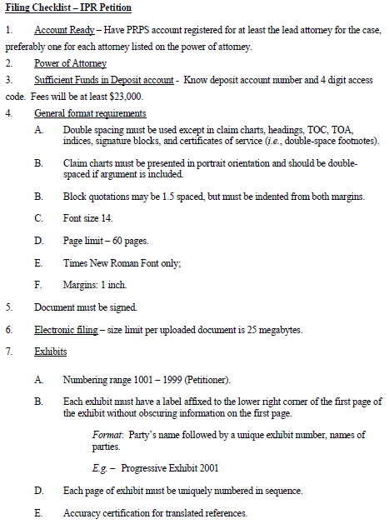
The Petition - Checklist

Slide 31
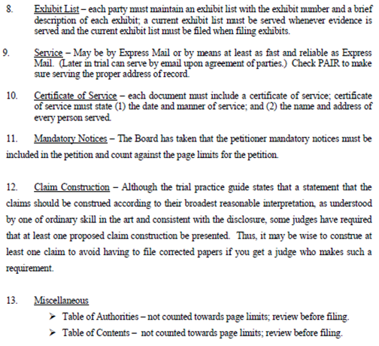
The Petition - Checklist

