Slide 1
PTAB Litigation 2016 Part 1 – PTAB Basics and Procedure

Slide 2
Introduction
The United States Patent and Trademark Office’s (USPTO’s) Patent Trial and Appeal Board (PTAB) has become one of the nation’s most active patent dockets.
Since PTAB’s introduction as part of the AIA on September 16, 2012, over 4100 petitions for PTAB post-issue trials have been filed – 1897 filed in fiscal year 2015 (Oct. 1, 2014 – Sept. 30 2015).
Initial estimates were about 500 petitions per year.

Slide 3
Types of PTAB Trials
Inter Partes Review (IPR) – IPR trials facilitate challenges to most patents under 35 U.S.C. § 102, 103 based on patent and printed publication prior art.
Post Grant Review (PGR) – Available for challenges to patents in the first 9 months after issue (only patents claiming priority after March 16, 2013). Expanded grounds over IPR including §§ 101, 112 and additional prior art challenges.
Covered Business Method (CBM) trials – Allows challenges of patents that meet the definition of a covered business method patent, without time period restrictions. Same grounds as PGR.

Slide 4
Standards of Review: IPR v. Litigation
In an IPR | In Federal Court
No presumption of validity | Presumed validity
To institute, must show a reasonable likelihood of prevailing | N/A
Invalidity shown by a preponderance of the evidence (>50%) | Invalidity shown by clear and convincing evidence (~ 90%)
Claims are given broadest reasonable interpretation | Claims are given ordinary and customary meaning

Slide 5
PTAB Rules and Trial Practice Guide
Part 42 of 37 C.F.R. is titled "Trial Practice Before the Patent Trial and Appeal Board.“
Rules 42.1-42.80 contains rules general to all flavors of PTAB trials;
Rules 42.100-42.123 contains rules specific to Inter Partes Review trials;
Rules 42.200-42.224 contains rules specific to Post-Grant Review trials; and
42.300-42.304 contains rules specific to Covered Business Method trials – Note that CBM trials also utilize several of the PGR trial rules (37 C.F.R. 42.300(a).
Trial rules and practice guide can be accessed at: http://www.uspto.gov/ip/boards/bpai/board_trial_rules_and_practice_guide.jsp

Slide 6
Trial Timeline

Slide 7
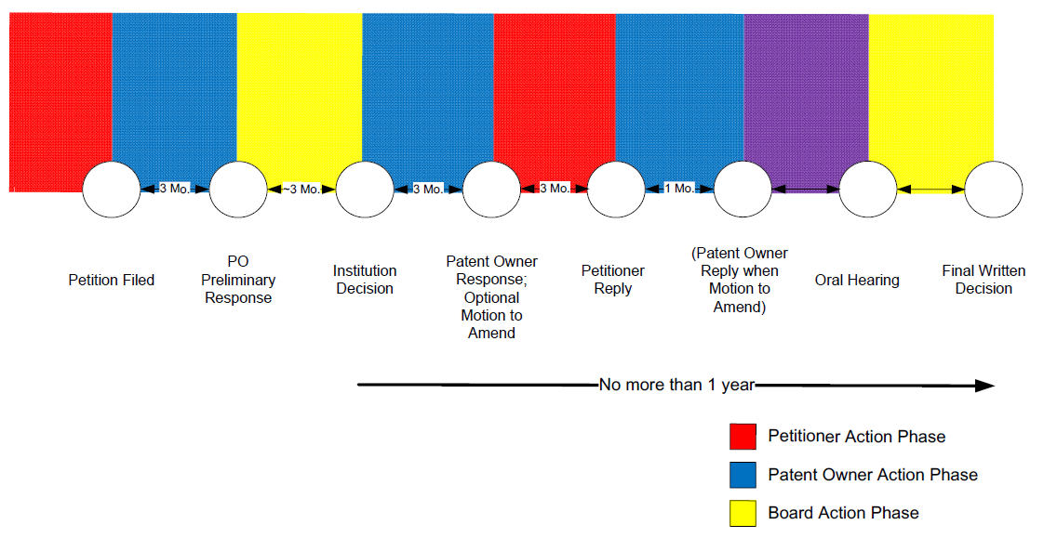
Trial Phases

